Slide 1



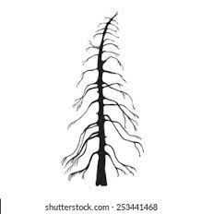

External Atmospheric Influences
Synoptic Weather
Micro-climate
Extreme Storms
COASTAL CRITICAL ZONE
External Marine Influences
Tides
Ice
Wave
Sea level
Erosion
Biological Coastal Processes
Anthropogenic Coastal Processes
External Terrestrial Influences
Fresh Water
Storm Water
Sedimentation
Management
Population Density
far shore
near shore
surf
foreshore
backshore
critical zone (transition) ecosystems
coastal geomorphology
re-envisioned from Nicholls et al. 2007
** not to scale**

